Slide 1
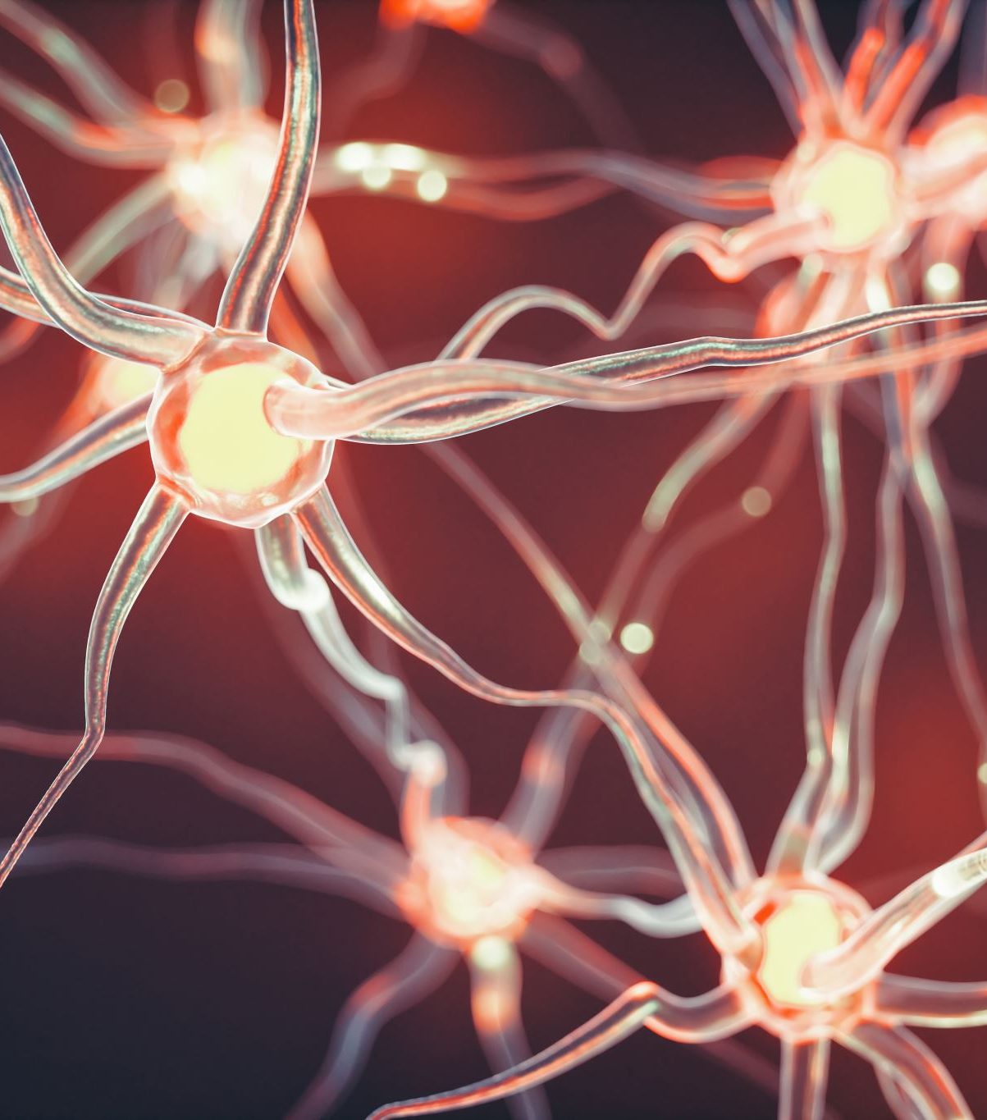
Effects of semantic relatedness and reward on hippocampal transitive inference
Florian Leprévost
Prof. Dr. Bianca Wittmann
Justus-Liebig-Universität Gießen –
BION meeting 2022

Slide 2
1.1 Associative Inference
1. Introduction
A
B
A
C
B
C
Notes:
What is AI

Slide 3
1.1 Associative Inference
1. Introduction
Associative inference
Hippocampal activity (Wimmer 2012)
Hippocampal connectivity (Wang 2020)
Reward – dopamine hippo (Kahnt 16)
Semantic association (Ryan et al., 2016)
Facilitates associative learning
And intact in hippocampus lesion
HPC
(associated) state computation
associated value computation
OFC
St
generalisation?
reinforcement learning
VTA
Notes:
what processes/areas involved

Slide 4

How does semantic memory and reward affect associative inference?

Slide 5

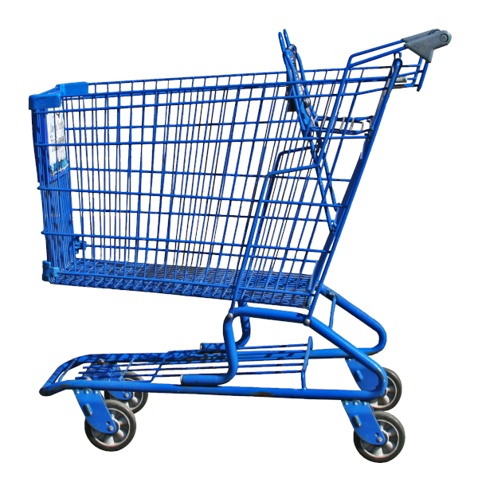

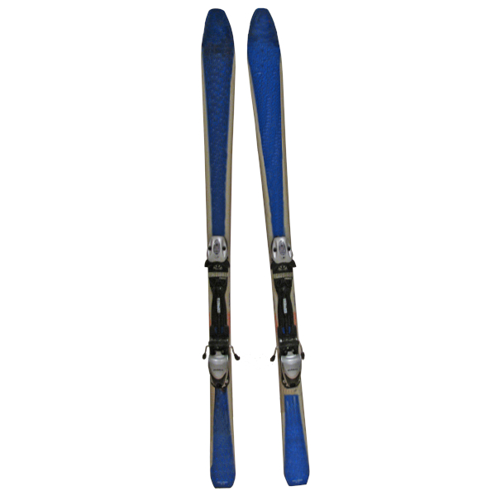




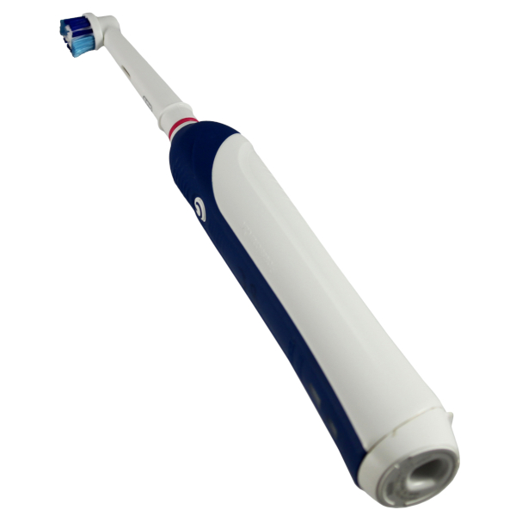

2.1 Design
2. Experiment
Semantic link
0 1
2 x 2
Semantic link
Reward
4 pairs of each = 16
Balanced
0
Reward
1

Slide 6
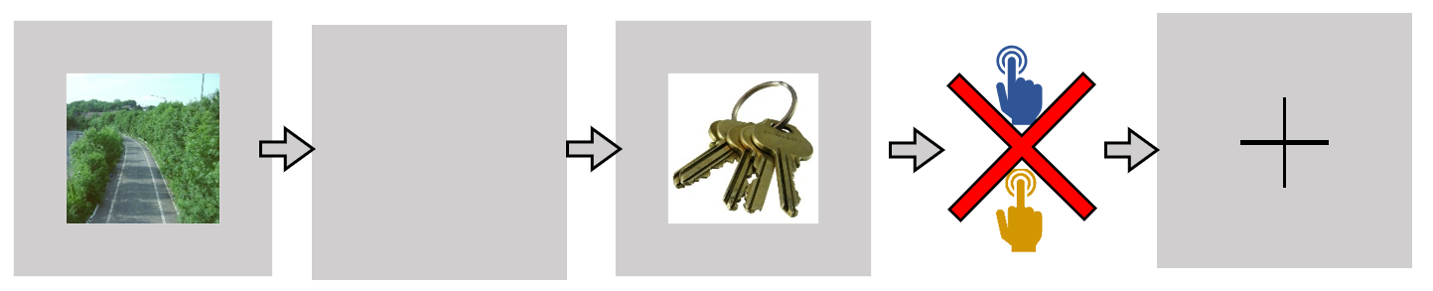
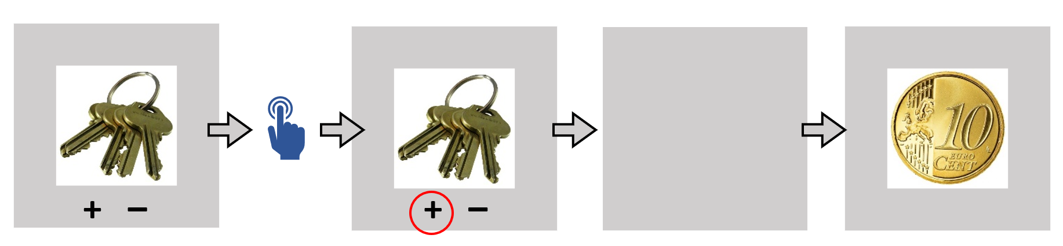
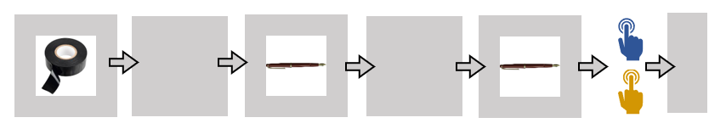
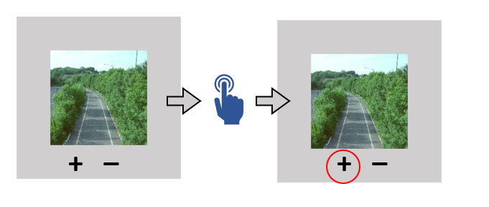
2. Experiment
Pre-conditioning
Conditioning
Functional localizer /Distractor (avoid recency effects)
Inference

Slide 7

2. Experiment
2.2 Time course
Preconditioning
16 S-O pairs, 6 runs x 1 rep
Conditioning
16 O-R pairs, 4 runs x 3 reps
Localizer Distractor task
N-1 task 8 blocks of 13stims
Inference
32 images, 2 runs x 2 reps
~ 14 min
S 1,5s + ISI 1s + O 1,5s + ITI 2,5s
~ 20 min
O 1,5s + ISI 1s + R 1,5s + ITI 2s
~ 4 min
0,3s ITI + 2s stim
~ 14 min
S1 1,5s + ISI 1s + O 1,5s + ITI 2s

Slide 8
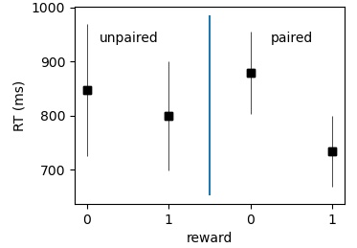
2. Experiment
2.3 Preliminary behavioral results
Semantic facilitation
n=4
Probe phase

Slide 9


3. fMRI
3.1 Functional Sequence
nb of slices = 50
Slice thickness = 3mm
TE = 30ms
TR = 2,8s
voxel size = 3x3x3mm
iPAT grappa 2 factor
30° tilt
interleaved
Semantic/Not
Reward/neutral
Regressors 2 *2
Additional Regressors
Head motion
Physio
Runs

Slide 10
3.2 Reactivation
3. fMRI
Univariate
Create Scenes & Objects masks from localizer
ANOVA 2 x2
Multivariate
SVM trained to classify specific Scenes & Objects patterns
Test to see if able to decode associated stimulus

Slide 11
3.3 Hippocampus activity & connectivity
3. fMRI
Activity in hippocampal mask
ANOVA 2 x 2
PPI
See if hippocampal-OFC and hippocampus-striatum connectivity mediated by semantic link, or inference performance

Slide 12
3. Hypothesis
For semantically linked pairs
More reactivation and in earlier runs for semantically linked pairs
Less hippocampus activity and connectivity
Interaction with reward
Reward affects inference only for NOT semantically linked

Slide 13
4. Conclusion
Associative inference
Semantic link & Reward
Reactivation analysis
Hippocampal role

